Slide 1
Wifi Mode

Slide 2
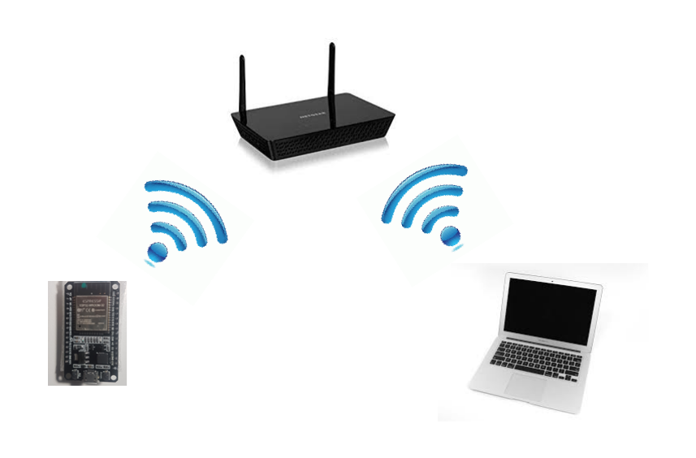
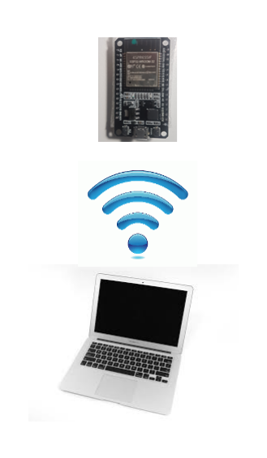
Wi-Fi Modes
Station STA
Access Point AP

Slide 3
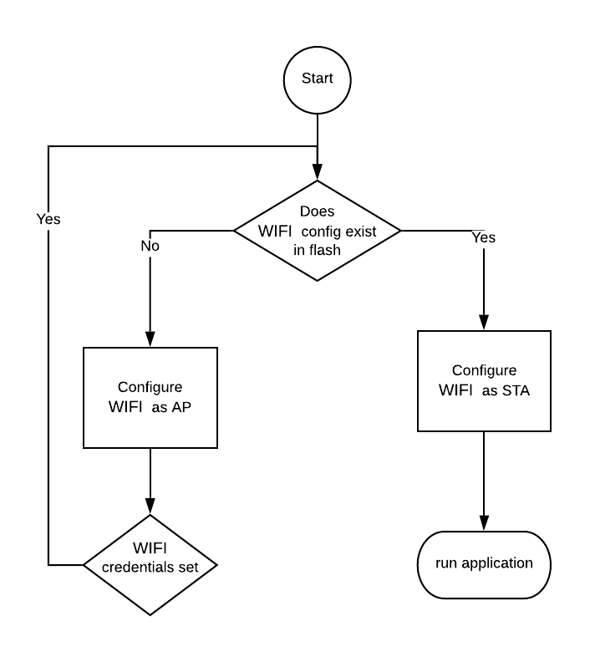
Switching wifi modes

